Slide 1
e4f-network.eu
Training module title:
Business plan for internationalization

Slide 2
Objectives and goals
At the end of this module you will be able to:
Demonstrate a systematic understanding and be able to apply concepts and skills relevant to the problems of managing and understanding the internationalization of Business.
Critically evaluate the contributions and weaknesses of the main theories of international business.
Demonstrate critical analytical skills related to the interpretation of global business strategy issues.

Slide 3
Index
Unit 1 Introduction
Unit 2 Be open to possibilities
Unit 3 Managing the Entering to new to markets
Section 1.2 Introduction
Section 2.1 Achieve growth
Section 3.1 Establish Export
Section 1.2 Objectives
Section 2.2 Improve profitability
Section 3.2 Use Direct Investment
Section 1.3 Goal
Section 2.3 Increase competitiveness
Section 3.3 Maintain team work
Unit 4 Plan Preparation
Unit 5 Impact on different functions of business
Unit 6 Communicate
Section 4.1 Define the objectives
Section 5.1 Human resources
Section 6.1 The importance of intercultural communication
Section 4.2 Allocate sufficient time resources
Section 5.2 Key factors of Finance
Section 6.2 Overcome the Barriers
Section 4.3 Ensure financial projections
Section 5.3 Optimize the Marketing
Section 6.3 Improve your intercultural business

Slide 4
Unit 1: Introduction
Section 1.1: Introduction
Internationalisation is the process of a company branching out to foreign markets to capture a greater market share.
The trend towards internationalization contributes to globalization - the state where economies worldwide become integrated due to cross-border trade and investments.
Internationalization may require companies to adapt their product features and branding to match the cultural and technological needs of the local market.
As the world becomes more of a global village, internationalization has gained much discussion in recent years. What exactly is internationalization? How can an international company enter new markets? What are the advantages and disadvantages of international expansion?
The attractiveness of a foreign market is assessed based on six factors:
1. The size and expected growth of the market
2. The accessibility of the market (geographical, political, legal, technological, social barriers)
3. The compatibility of different markets in the company’s portfolio
4. Resource availability and the distance to the target market
5. Competitive environment
6. External influences (PESTLE)

Slide 5
Unit 1: Introduction
Section 1.2: Objectives of Internationalization
One of the significant advantages of international trade is market diversification. Becoming less dependent on a single market can help you avoid risks in your core market. Companies would have the opportunity to increase their brand awareness in a marketplace where their competitors have not yet entered.
To increase national and international visibility
To enhance institutional strengths through strategic partnerships
To mobilize and leverage internal intellectual resources

Slide 6
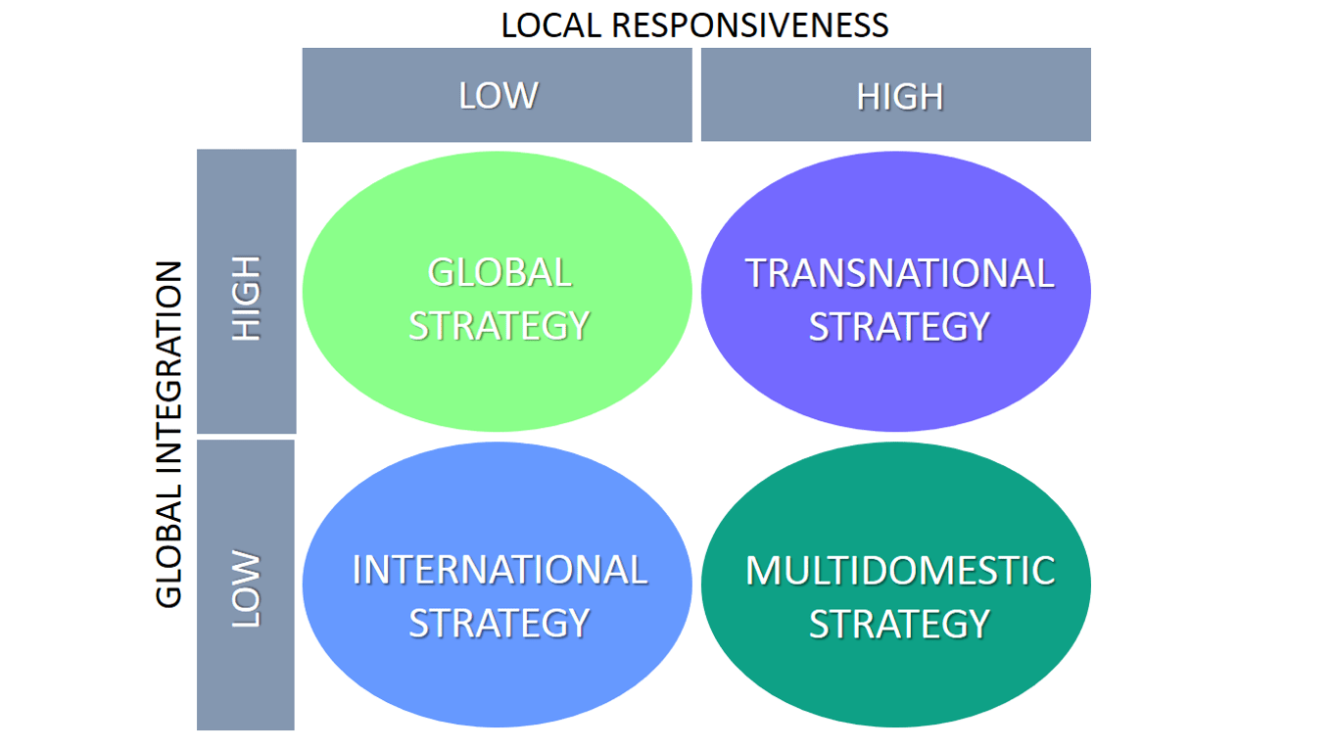
Unit 1: Introduction
Section 1.3: Goal
Setting specific, measurable, actionable and time-bound goals for entering new markets around the world is a key to gaining a solid foothold in the global marketplace.

Slide 7
Summing up
Companies with a multidomestic strategy have as aim to meet the needs and requirements of the local markets worldwide by customizing and tailoring their products and services extensively
Business internationalization strategy
Goal
Setting specific, measurable, actionable and time-bound goals for entering new markets around the world is a key to gaining a solid foothold in the global marketplace.

Slide 8
Unit 2: Be open to possibilities
Section 2.1: Achieve growth
The local market may have a limited customer base or become saturated over time, expanding overseas is the only for businesses to increase their market share and continue growing.

Slide 9
Unit 2: Be open to possibilities
Section 2.2: Improve profitability
International businesses can take advantage of marketing and technological advantages in the host country or introduce higher prices to new customers to achieve higher profits.

Slide 10
Unit 2: Be open to possibilities
Section 2.3: Increase competitiveness
Companies operating overseas have greater economies of scale to lower the cost of their business and be more competitive. The presence on a global scale also boosts the company’s reputation and allows it to attract more customers compared to local businesses.

Slide 11
Achieve growth
Expansion abroad is the only option for companies to increase their market share and continue their growth.​​
Improve profitability
Exploiting market and technological advantages to achieve profit
Increase competitiveness
A global presence also strengthens the company's reputation

Slide 12
Unit 3: Managing the Entering to new markets
One major challenge of an international business is to manage change in an effective and coherent manner.
Section 3.1: Export
Set up a direct investment. The company setups manufacturing overseas or takes over or merges with a foreign business. Although direct investment allows the business to cut down on tax and transportation costs, it’s also the highest risk and most expensive option out of four market entry modes.

Slide 13
Unit 3: Managing the Entering to new markets
Section 3.2: Licening/Francising
The original business licenses other firms to manufacture and sell its products. The licensee pays a fee to reserve a trademark of the licensor’s products. Franchising is the same as licensing, only that the original business still has some control over the manufacturing and marketing processes of the licensees. This approach is much more economical than setting up a foreign facility or taking over the local business.

Slide 14
Unit 3: Managing the Entering to new markets
Section 3.3: Joint ventures
Establish joint ventures. The company partners with an overseas business take advantage of its know-how upon entering a new market.

Slide 15
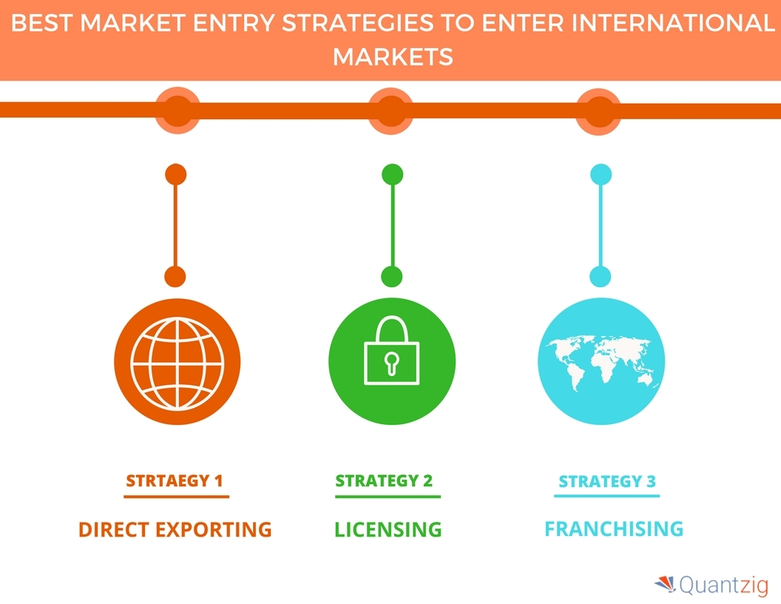
Unit 3: Managing the Entering to new markets

Slide 16
Set up a direct investment
The company setups manufacturing overseas or takes over or merges with a foreign business.
Discover Licensing
The original business licenses other firms to manufacture and sell its products.
Establish joint ventures
Taking advantage of other companies know-how.

Slide 17
Unit 4: Plan Preparation Guidelines
Section 4.1: Clearly define the objectives for producing the plan
Who is going to read the plan, and what will they need to do? These objectives can help you decide how much emphasis to put on various sections.
The international business plan is the culmination of all of the work done to determine the appropriate venture for the organization’s growth. As part of the feasibility process, the organization will have determined its own internal readiness, conducted comprehensive target market research and carefully analyzed any relevant risks

Slide 18
Unit 4: Plan Preparation Guidelines
Guidelines that help managers to make better decisions
Section 4.2: Allocate sufficient time and resources to thoroughly research the plan
A plan is only as good as the research that went into producing it.

Slide 19
Unit 4: Plan Preparation Guidelines
Section 4.3: Ensure financial projections are believable
For many readers, the financial section is the most important part of the plan because it identifies the financing needs and shows the profit potential of the business. In addition, a good financial plan will give the reader confidence that the author really understands the business.

Slide 20
Define the objectives for producing the plan
To decide how much emphasis to put on various sections.
Allocate sufficient time and resources
A plan is only as good as the research that went into producing it.
Ensure financial projections are believable
A good financial plan will give the reader confidence that the author really understands the business.

Slide 21
Unit 5: Impact on different functions of business
Section 5.1: Human resources
Internationalization processes can lead to changes in the Human and Resources department of the company.
Managers may need to go under training or get advice from advisors to hire an international workforce.
Multinational companies may also face cultural and legal problems when hiring and motivating foreign workers.
Offshoring may trigger resentment among underpaid workers in developing countries.
Licensing and franchising may require the company to develop thorough training programs to maintain the quality and culture of the original business.
Internationalization can affect various business functions, including human resources, finance, marketing, operations, and management.

Slide 22
Unit 5: Impact on different functions of business
Section 5.2: Marketing
A lot of marketing decisions are associated with the internationalization process.
Extensive market research has to be carried out to ensure the product is needed abroad Some customers may prefer a product made in a certain country than the other, e.g. Made in the UK.
Introducing new products to a foreign market also uses up a considerable amount of market. There are also marketing costs to competing with businesses in the host country.

Slide 23
Unit 5: Impact on different functions of business
Section 5.3: Finance
The expansion to other territories requires a substantial investment which incurs many risks for the international business.
Setting up a manufacturing facility broad or acquiring a foreign business can take up a lot of financial resources. However, there’s no guarantee this will generate a positive return.
Offshoring can reduce costs of production but there might be hidden costs when the company switched back to producing locally.
Franchising, licensing, and exporting are much less risky ways in terms of finance for a global business.

Slide 24
Human resources
Internationalization processes can lead to changes in the Human and Resources department of the company.
Marketing
A lot of marketing decisions are associated with the internationalization process.
Finance
The expansion to other territories requires a substantial investment

Slide 25
Unit 6: Communication
Section 6.1: The importance of intercultural communication
In business, intercultural communication allows individuals to interact respectfully and constructively. It encourages the finding of common ground and an honoring of differences.
Intercultural communication is equally important in person, on the phone, and even via email or text message. It can help with things like:
Creating a hiring process that prioritizes hiring diverse candidates
Fostering existing client relationships
Improving internal communication within a diverse, intercultural team.

Slide 26
Unit 6: Communication
Section 6.2: Overcome the Barriers
While intercultural communication is important, it doesn’t always come easy. Numerous communication barriers can threaten the integrity of an organization, such as:
Assuming similarities: assume cultural similarities between individuals,
Language barriers: The inability to overcome language barriers can be one of the most intimidating communication barriers of them all.
Ethnocentrism: The tendency to assume the superiority of one’s own culture can often hamper intercultural communications.

Slide 27
Unit 6: Communication
Section 6.3: Improve your intercultural business
Educate yourself
Learn a language
Be aware of nonverbal communication
Simply making an effort to learn another individual’s language — no matter how successful that effort may be — shows that you care and are invested in meeting the other person on their terms.
Educating yourself through communication can help you round out your view of different cultures and approach each interaction with an open mindset.
Numerous nonverbal factors can help inform the conversation. Things like posture, eye contact, and tone of voice can all be critical.

Slide 28
The importance of intercultural communication
intercultural communication allows individuals to interact respectfully and constructively.
Barriers
Numerous communication barriers can threaten the integrity of an organization
Improve your intercultural business
Educate yourself
Learn a language
Be aware of nonverbal communication

Slide 29
e4f-network.eu
Thank you!

