Slide 1
International digital marketing:
strategies and tools

Slide 2
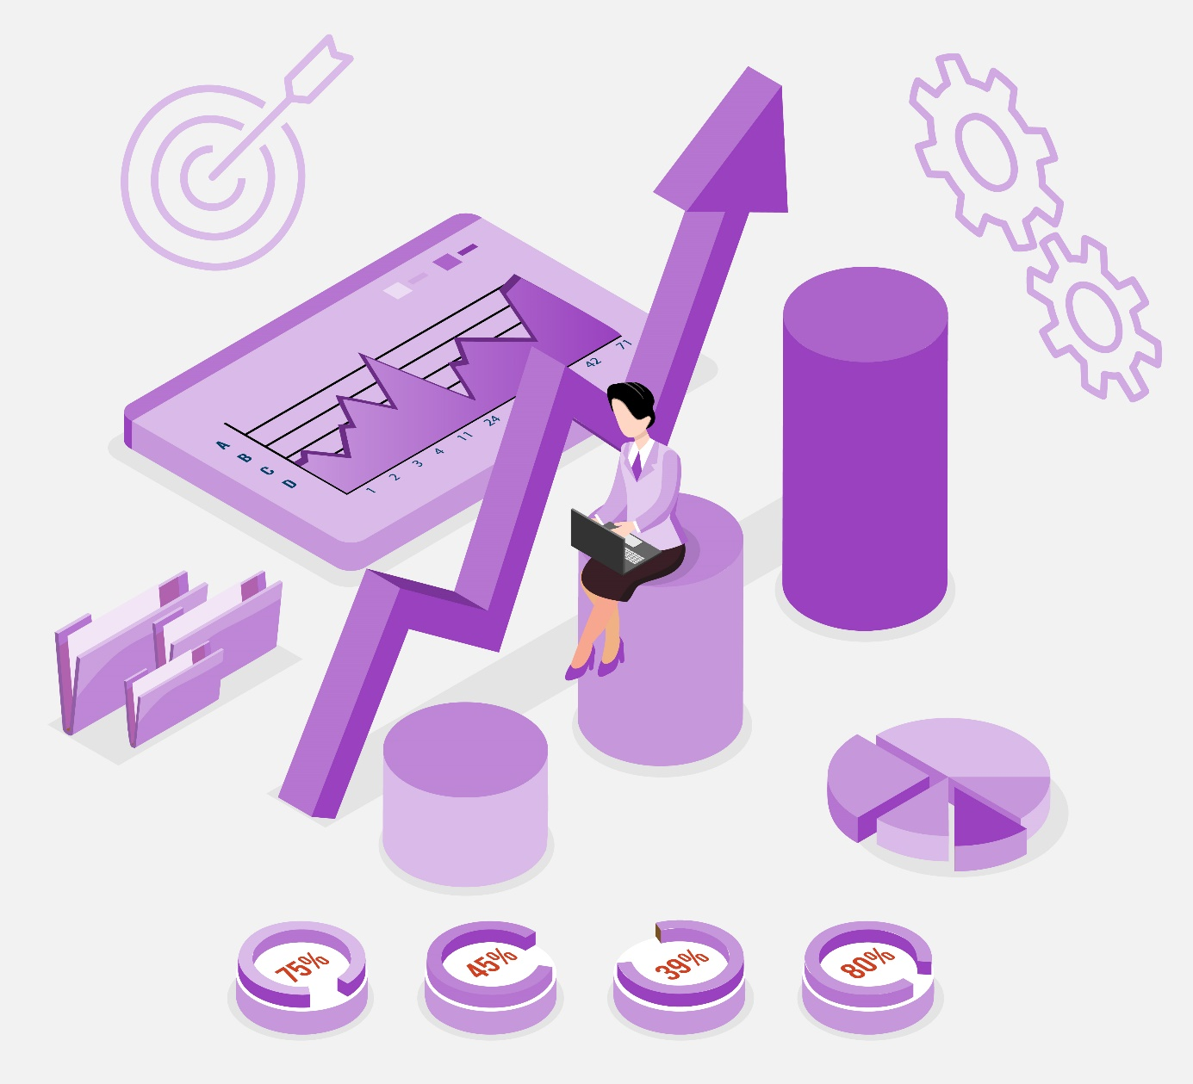
Objectives and goals
At the end of this module you will be able to:
Learn about diferent types of digital marketing
Plan and manage a digital marketing campaign
Learn about the main marketing tools

Slide 3
Index
Unit 1: Introduction.
What is international digital marketing?
Unit 2: Successful strategies for your international digital marketing campaign.
Unit 3: Main tools.
Unit 4: Recommendations and Tips. Do's and Dont's
International digital marketing
Types of digital marketing
Multichannel and omnichannel models
RACE Framework
RACE: Reach
RACE: Act
RACE: Convert
RACE: Engage
Social media marketing tools
SEO (search engine optimization) tools
Conversion optimization tools
Other useful tools
General tips
Do’s and Don’ts

Slide 4
1. Introduction. What is international digital marketing?
1.1 International digital marketing
International digital marketing (also known as online marketing) refers to the use of any number of digital channels to advertise and promote products and services in a international market.
Its aim is to reach and connect potential customers through internet and any forms of digital communication.
It can also be very useful to approach consumers and understand their behavior.

Slide 5
1. Introduction. What is digital marketing?
1.2 Types of digital marketing
It is possible to classify the different types of digital marketing according to the channel used.
Website Marketing → Promotion of a website to drive relevant traffic to the site
Pay-Per-Click (PPC) Advertising → The advertiser pays a fee only when a user actually clicks on the advertisement
Content Marketing → Creation and distribution of valuable and relevant content
Email Marketing → Using e-mail as a means of communicating messages to the target audience
Social Media Marketing → Using social media to generate visibility and interactions
Affiliate Marketing → Process by which an affiliate earns a commission for marketing another person's or company's products
Video Marketing → Based on the use of the audiovisual image

Slide 6
1. Introduction. What is digital marketing?
1.3 Multichannel and omnichannel models
Companies often choose to reach potential customers combining traditional and digital marketing techniques.
There are too ways to combine this types of marketing
channels:
Multichannel
Omnichannel
Physical Store
Mobile
Online Marketplace
eCommerce
User
eCommerce
Online Marketplace
Mobile
Physical Store
User
Multichannel: the use of all channels (physical store, mobile, online marketing) to contact customers without a connection between the channels.
Omnichannel: a modality that provides seamless integration and response between the channels.

Slide 7
Summing up
International marketing refers to the promotion of products in a international market
Digital marketing refers to the use of digital channels to advertise products and services
It is possible to classify the types of digital marketing according to the channel used
There are too ways to combine this types of marketing
channels: Multi and Omni channel models

Slide 8
2. Successful strategies for your digital marketing campaign.
2.1 RACE Framework: Plan
PLAN
RACE is a practical framework to help marketers and business owners to plan and manage their digital marketing strategy and improve results from it. This framework consists of an initial planning moment, followed by 4 strategic phases covering the entire customer life cycle.
REACH
ACT
Nowadays, a lot of companies do digital marketing but many of them do so without prior planning and a well-defined strategy. However, planning a digital marketing strategy in a well-structured manner is essential for it to have good results at the lowest possible cost. It is advisable to take a data-driven approach when planning.
CONVERT
ENGAGE

Slide 9
2. Successful strategies for your digital marketing campaign.
2.2 RACE: Reach
PLAN
At this stage, it is important to reach as many potential customers as possible by exploiting multiple types of channels, possibly with an omnichannel model. This is the time to create awareness of the brand, products and services.
REACH
The online marketing techniques that can be used are constantly evolving. One must continue to study them and stay up-to-date because our digital marketing strategy must include the latest online marketing techniques.
ACT
CONVERT
ENGAGE

Slide 10
2. Successful strategies for your digital marketing campaign.
2.3 RACE: Act
PLAN
This is the phase to generate actions and interactions in one's channels (website, social media, etc.). Keep in mind that the aim now is to influence the behaviour and next steps of the audience reached in the previous phase.
REACH
The specific goals to be set depend on the type of company.
Certainly the first is to generate leads. The others can range from getting interested and finding out more about the company and its products, reading the company blog, searching for products and much more.
ACT
CONVERT
At this stage, content marketing can be very useful to entertain, educate, inspire and convince the potential customers reached.
ENGAGE

Slide 11
2. Successful strategies for your digital marketing campaign.
2.4 RACE: Convert
PLAN
This is where the crucial step takes place: the conversion from action into sale (both online and offline) and from potential customer into paying customer.
REACH
This is a good time to exploit marketing techniques such as:
Retargeting (or remarketing). Reaching out previous visitors;
Lead nurturing. Set of activities, actions or practices aimed at creating a relationship with contacts potentially interested in a product or service, through
the delivery of relevant and customized content;
Website personalization. Creating customized experiences for visitors to a website tailored to their needs and desires;
Conversion rate optimization (CRO). Process of figuring out what your visitors are looking for when they come to your website and ensuring that they find it.
ACT
CONVERT
ENGAGE

Slide 12
2. Successful strategies for your digital marketing campaign.
2.5 RACE: Engage
PLAN
After the first purchase of a new customer, work on customer loyalty. The aim is to develop long-term engagement, commitment and relationship with the customer.
REACH
At this stage we have already collected enough data on the behaviour of the new customer. This data can be exploited to create hyper-personalised marketing campaigns and communications
ACT
This is also the right time to measure the percentage of active customers and their satisfaction level.
CONVERT
ENGAGE

Slide 13
Summing up
RACE is a framework that can help to plan and manage digital marketing strategies
This framework consists of an initial planning moment, followed by 4 strategic phases
RACE stands for: Reach Act Convert Engage
It is advisable to take a data-driven approach when planning

Slide 14
3. Main tools.
3.1 Social media marketing tools
Sprout Social: a social media management platform that helps business organise their content calendar, publish and schedule content across multiple platforms and according to when followers are most active, and simplify collaboration with colleagues and customers.
Loomly: this “brand success platform” is ideal to collaborate efficiently within marketing teams. It has a variety of features such as built-in calendars, content library, optimization guide and tips, post ideas based on trending topics, analytics and much more.
Audiense: this platform can help business in the processes of audience segmentation and targeting, and advertising by putting social listening, consumer segmentation and cultural understanding at the center of the marketing strategy.

Slide 15
3. Main tools.
3.2 SEO (search engine optimization) tools
Ahrefs: an all-in-one SEO toolset: it has a project dashboard, site explorer, keywords explorer, site audit, rank tracker and content explorer.
Clearscope: a platform that provides a detailed editor to recommend keywords, headers and readability to help you write (or rewrite) high-ranking, well-balanced blog posts and optimize your existing contents.
SEMrush: This platform contains tools for social media marketing, content marketing and much more. In particular, it is also a great tool for SEO, as it allows you to track the position of your priority keywords and likewise explore new terms to rank for.

Slide 16
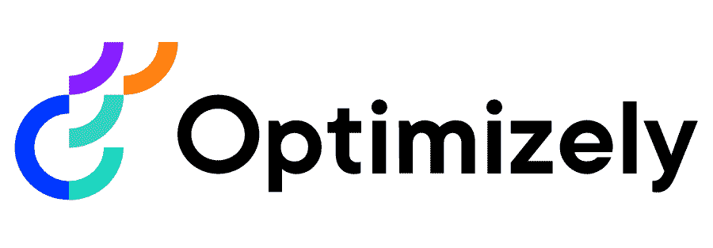
3. Main tools.
3.3 Conversion optimization tools
Unbounce: an AI-powered landing page builder with smart features that let you create high-performing marketing campaigns in just a few minutes to turn more of your visitors into customers.
Optimizely: Optimizely Digital Experience Platform combines tools for visual creation and audience targeting to quickly run tests on different segments of your audience. It also allows you to test both major and minor edits to your pages and fine-tune your site for performance.
Hotjar: a platform with powerful marketing tools such as: heatmaps that visually represent where users click, move, and scroll on your site; actual video recordings of your visitor’s journey (scrolling, moving, u-turning, and rage clicking) on your site; live feedback and much more.

Slide 17
3. Main tools.
3.4 Other useful tools
Sendgrid: a suite of tools to create engaging email campaigns.
Typeform: a platform that allows you to create forms, surveys, and quizzes that people enjoy answering. It helps you to keep your audience engaged and get more thoughtful responses and higher completion rates.
Canva: is a tool that allows you to create visual content with which to engage your audience and develop your brand. it is ideal for working in collaboration with other people, even without graphic design experience.
Powtoon: another very intuitive graphic tool that allows you to create videos and presentations with text, images, characters and animations. This platform also offers the possibility of working on your own projects in collaboration with others.

Slide 18
Summing up
There are several tools that can help to plan and manage the international digital marketing
The main ones can be divided in: Social media marketing, SEO and Conversion optimization tools
There are also useful tools that can help with the graphic aspects of marketing campaigns

Slide 19
4. Recommendations and Tips. Do's and Dont's
4.1 General tips
Know your target audience
Get an insight into their behaviour, their demographics, and their taste. Try A/B testing and see what your audience likes and dislikes. Address your product to the right audience instead of the mass audience.
Know your brand and competition
When you invest in digital marketing, it is crucial to building a strong branding strategy and keeping a close eye on what the competitors are doing is unskippable.
Find the right channels
When you have a target market and you have to reach them effectively, you need to identify the right channel where you can reach out to them with your content.

Slide 20
4. Recommendations and Tips. Do's and Don'ts
4.1 General tips
Create engaging content
Make sure you are using high-quality photos, selecting pleasing fonts and colors, and making them useful to your audience.
Be consistent
This way your audience can regularly find your content and engage with it, and your consumers will know that you are active.
Be flexible in the international market
Research and find about the cultural values of the country in which you operate. You often need to change your marketing strategies (as well as your business model) according to the country. What works in your market may not work in other contexts.

Slide 21
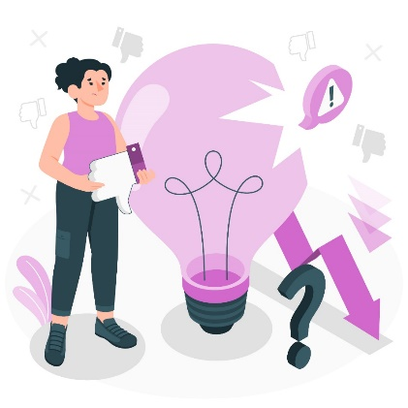
4. Recommendations and Tips. Do's and Don'ts
4.2 Do’s and Don’ts
DO… | DON’T…
Set realistic goals Implement clear and concise calls-to-action Invest in a business blog Optimize for a mobile-friendly website Integrate personalization in your customer journey Keep your website updated Create country-specific websites | X Be afraid to ask for professional help X Place quantity over quality X Spam or Overshare X Ignore or underestimate email marketing X Be impatient X Overlook video in your marketing mix X Forget to optimize for local search X Forget to double-check translations

Slide 22
Summing up
It is advisable to know the brand, the target audience and the competition, and to find the right channels
It is advisable to create engaging contents, to be consistent and flexible in the international market

Slide 23
Thank you!

