Slide 1
e4f-network.eu
Training module title:
Customs, International IPR, Legal Aspects

Slide 2
Objectives and goals
At the end of this module you will be able to:
Learn more about the essentials of Intellectual Property Rights (IPR)
Recognize the different typologies of IPR and how they are applied
Get familiar with the basic legal implication of International Business

Slide 3
Index of Content
Unit and sections
UNIT 1: IPR and International Trade
Section 1.1: What is Intellectual Property
Section 1.2: Examples of IPR
Section 1.3: Typical cases of IPR violation
UNIT 2: Legal aspects of an International Business
Section 2.1: International Commercial Transactions
Section 2.2: Legal Issues in international business transitions
Section 2.3: Chioce of Law
Section 2.4: E-Contractual form

Slide 4
Unit 1: IPR and International Trade
Section 1.1: What is Intellectual Property
Intellectual property (IP) refers to creations of the mind, such as inventions; literary and artistic works; designs; and symbols, names and images used in commerce.
Definition provided by World Intellectual Property Organisation (WIPO)
Intellectual Property Rights (IPR)
Legal, private enforceable rights granted to inventors and artists by governments.
IPR are designed to promote creativity and innovation.
Following the expiration of these rights, other inventors, artists, and society at large can build on them.

Slide 5
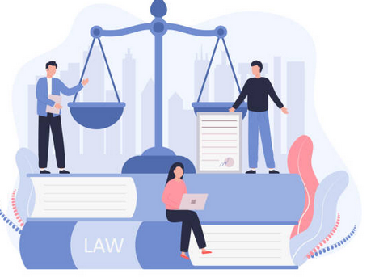
Unit 1: IPR and International Trade
Section 1.1: What is Intellectual Property
IPR usually grants right holders time-limited monopolies to use, sell, and promote their works while preventing others from doing the same without their permission (acts referred to as infringements).

Slide 6
Unit 1: IPR and International Trade
Section 1.1: What is Intellectual Property
Traditionally, IP sources have been issued by developed countries, however developing markets are also becoming key IP providers.
Globally, by nation, the United States is the largest dealer in IP licensing fees, but the EU as a whole is the largest.
Many traded products and services are IP-based, and licenses and fees earned by IP use are specifically a component of services trade.

Slide 7
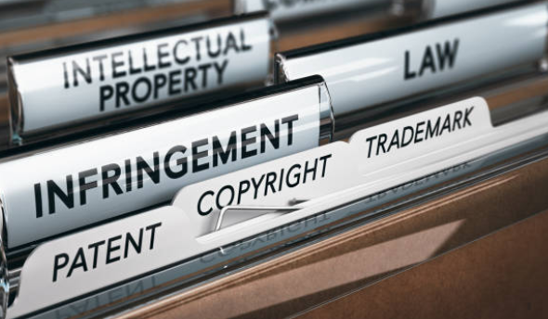
Unit 1: IPR and International Trade
Section 1.2: Examples of IPR
Official definitions from World Intellectual Property Organisation (WIPO)
PATENTS
A patent is an exclusive right granted for an invention, which is a product or a process that provides, in general, a new way of doing something, or offers a new technical solution to a problem. To get a patent, technical information about the invention must be disclosed to the public in a patent application.
COPYRIGHTS
Copyright (or author’s right) is a legal term used to describe the rights that creators have over their literary and artistic works. Works covered by copyright range from books, music, paintings, sculpture, and films, to computer programs, databases, advertisements, maps, and technical drawings.
TRADEMARK
A trademark is a sign capable of distinguishing the goods or services of one enterprise from those of other enterprises (a combination of words, letters, symbols and shapes, colours, sounds, etc.). Trademarks are protected by intellectual property rights
TRADE SECRETS
Trade secrets are intellectual property (IP) rights on confidential information which may be sold or licensed.
GEO INDICATIONS
A geographical indication (GI) is a sign used on products that have a specific geographical origin and possess qualities or a reputation that are due to that origin. In order to function as a GI, a sign must identify a product as originating in a given place.

Slide 8
Unit 1: IPR and International Trade
Section 1.2: Examples of IPR - Patents
If you are the sole owner of a patent, the invention to which the patent applies cannot be used (i.e., distributed, imported, sold, fabricated) without your formal consent.
The patent remains in force with all its effects for a period of 20 years – starting from the very moment of its application.
Patents are not valid in every country: the right that the given patent guarantees are limited to the country of application, and in accordance with the given territorial law (if any).

Slide 9
Unit 1: IPR and International Trade
Section 1.2: Examples of IPR – Copyrights
Broadly speaking, copyrights applies to works that are commonly referred as “creative” products, but not to the ideas, methodologies, processes that lead to their creation.
Recording
Broadcasting
Public performance
Miscellaneous (reproduction in various forms)

Slide 10
Unit 1: IPR and International Trade
Section 1.2: Examples of IPR – Copyrights
The owner of the copyright acquires two rights:
ECONOMIC rights – the owner can claim the financial rewords from the use of the artwork from others
MORAL rights – the owner can claim non economic related rewards from the use of the artwork from others (i.e. authorship, status and recognition)
Please note that although copyright protection is obtained without formal registration, most countries have in place their own validation system put in place to avoid any unpleasant dispute

Slide 11
Unit 1: IPR and International Trade
Section 1.2: Examples of IPR – Trademarks
Trademark protection lasts for 10 years, and can be renewed as many times as possible – upon payment of a fee.
The application for trademarks is done at national / territorial level, and remains in force limited to the region of application.
For registration at international level, you can register your trademark in each national office you are interested of or by application through WIPO.

Slide 12
Unit 1: IPR and International Trade
Section 1.2: Examples of IPR – Trade secrets
In order to qualify as a trade secret, the underlying information / communication needs to have three distinguishing features:
Of Economic value (commercial and technical information that guarantees for a competitive edge)
Known only to few / a selected group of people
Unequivocally wanted secret / not disclosed by the owner(s)
Other common trade secrets might include: financial info, chemical formula, codes and any other sort of sensate date to public disclosure.

Slide 13
Unit 1: IPR and International Trade
Section 1.2: Examples of IPR – Geographical indications
Typical of agri-food and handicraft products: industries in which the place of origin of the good stands as an assurance for its quality, performance and uniqueness.
The GI owner is allowed to use the geographical indication in communicating, marketing and branding the product, but cannot prevent others from using the some production techniques for instance.
GIs applies to any instance in which there is a clear, recognizable and popular connection between the product and the place of origin.

Slide 14
Unit 1: IPR and International Trade
Section 1.3: Typical cases of IPR violation
Infringement, counterfeiting, and theft of trade secrets are examples of serious intellectual property infractions. Other “traditional” violation scenarios include:
Falsification
Creating a logo or name to fool consumers into believing they are purchasing the actual brand.
Piracy
Unauthorized video or music recording or duplication of copyrighted content (even on a photocopier for private use).
Patent violation
Taking another person's patent and passing it off as your own.

Slide 15
Summing up
Intellectual Property
IPR
Creations of the mind, such as inventions; literary and artistic works; designs; and symbols.
Legal, private enforceable rights granted to inventors and artists by governments.
Examples of IPR
Violations of IPR
Patents
Copyright
Trademarks
Trade Secrets
G. I.
Falsification
Piracy
Violation of patents

Slide 16
Unit 2: Legal Aspects of an International Business
Section 2.1 International Commercial Transactions
Any form of arrangement involving partners from at least two different nations is considered an international commercial transaction.
International transactions might include sales, licensing, and investments.
An international commercial transaction can be also an e-commerce transaction.
Individuals, small and big multinational corporations, and even nations are all participants to international economic transactions.

Slide 17
Unit 2: Legal Aspects of an International Business
Section 2.2 Legal Issues in International Commercial Transactions
Contracts for products and services agreed on by parties can sometimes result in legal complications.
Goods are sold against letters of credit, guarantees, and post-arrival payments, and all of these aspects of foreign trade result in legally enforceable contracts.
When something goes wrong with the transaction, the contract raises legal concerns such as jurisdiction, applicability of law, interpretation, and execution of decision.

Slide 18
Unit 2: Legal Aspects of an International Business
Section 2.3 Choice of Law
In the event of private parties to an international commercial transaction, the arising difficulties are normally controlled by the conflict of laws principle, which states that the jurisdiction is determined by the law of the place of residence.
The Choice of Law clause to the contract may specify which jurisdiction is applied in the case of conflict.
In the EU, the law applicable to contractual obligations is the Regulation is the Regulation (EC) No 593/2008, also known as Rome I Regulation.

Slide 19
Unit 2: Legal Aspects of an International Business
Section 2.4 E-Contractual form
Online businesses post documents comprising “terms and conditions of usage” or “terms of service” on their websites.
These documents are a new type of contract that originated in the internet age, and they are essentially adhesion contracts (a contract drafted by a party in a position of power, leaving the other party to accept or decline all of the offered services).

Slide 20
Summing up
International
Transactions
Examples of
Legal issues
Arrangements involving partners from at least two different nations.
Choice of law
Contractual form
Accountability

Slide 21
e4f-network.eu
Thank you!

